Slide 1

San Jose: Xiaoge Zhang

Slide 2
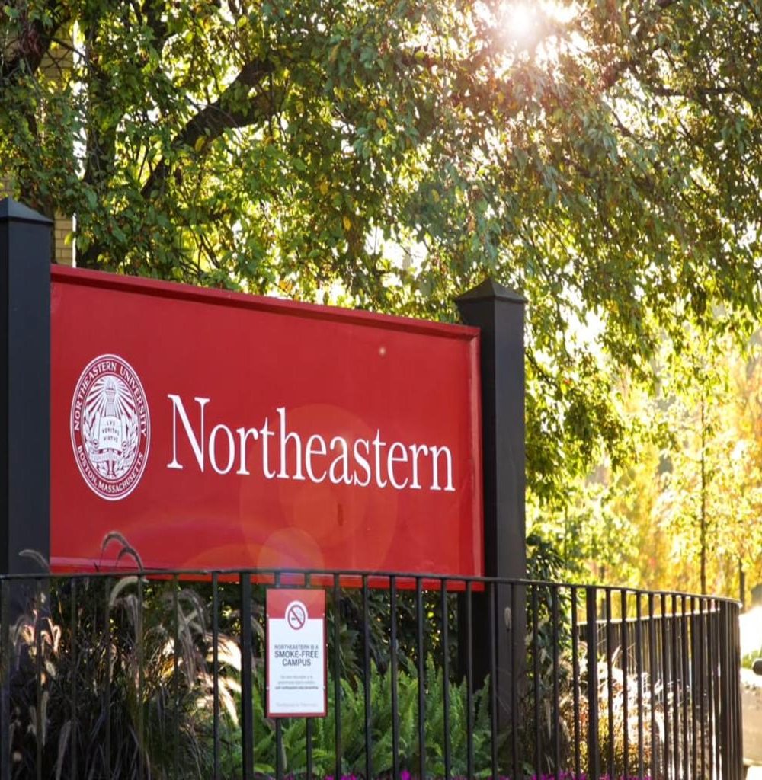
Inspiration
As a student at the Northeastern University, I understand the frustration of coordinating carpools through a group chat.
The back and forth messaging to coordinate schedules and locations is time-consuming and inconvenient.

Slide 3
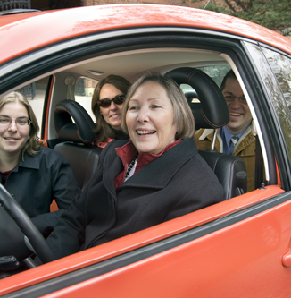
What it does?
The TogetherRide app designed specifically for students connects with other students and allows them to easily coordinate carpools based on their academic and work schedules.
The app promotes environmentally-friendly and community-driven transportation by making it simple for students to arrange carpools, reducing their carbon footprint and saving time and effort in the planning process.
The app integrates a scheduling system that matches students with compatible carpool partners, streamlining the process and making it a breeze to coordinate rides.

Slide 4
How Can I build it?
The TogetherRide app was built using a combination of cutting-edge technologies and a user-centered design approach.
Tech Stack: The app will be developed using a combination of JavaScript, React Native, and Node.js. The backend will be built using MongoDB to store user data, and the app will be deployed on the cloud using Microsoft Azure.
User-centered design: The app will be designed with the user in mind, taking into account the unique challenges and needs of students when it comes to carpooling. The interface is intuitive and user-friendly, making it easy for students to connect and coordinate carpools.
Integration with schedules: One of the key features of the app is the integration with the users' academic and work schedules. The app uses machine learning algorithms to match students with compatible carpool partners and suggest optimal times and routes.
Environmental impact tracking: The app also tracks the carbon savings made by each carpool and provides users with regular updates on their impact. This helps to promote environmentally-friendly behavior and incentivize students to carpool more often.
By bringing together advanced technology and a user-centered design approach, our carpool app makes it easy and enjoyable for students to share rides and reduce their carbon footprint.

Slide 5

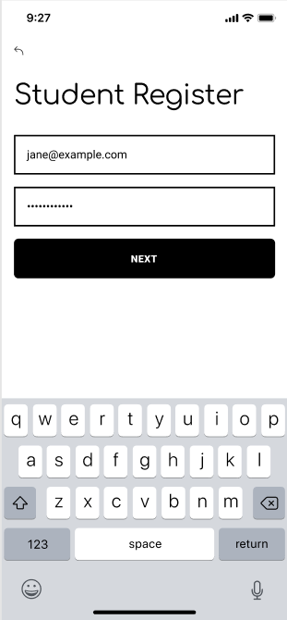
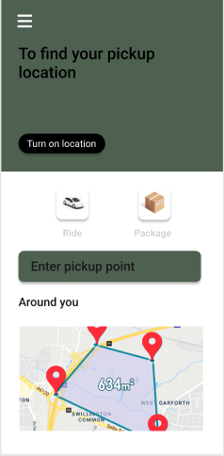
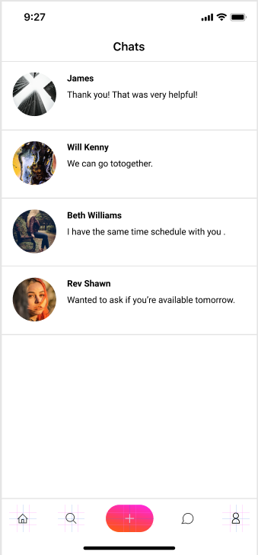
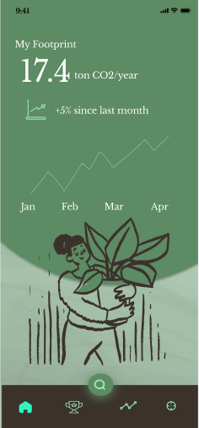
Logged out
Register
Input Info
Chats
Footprint

Slide 6
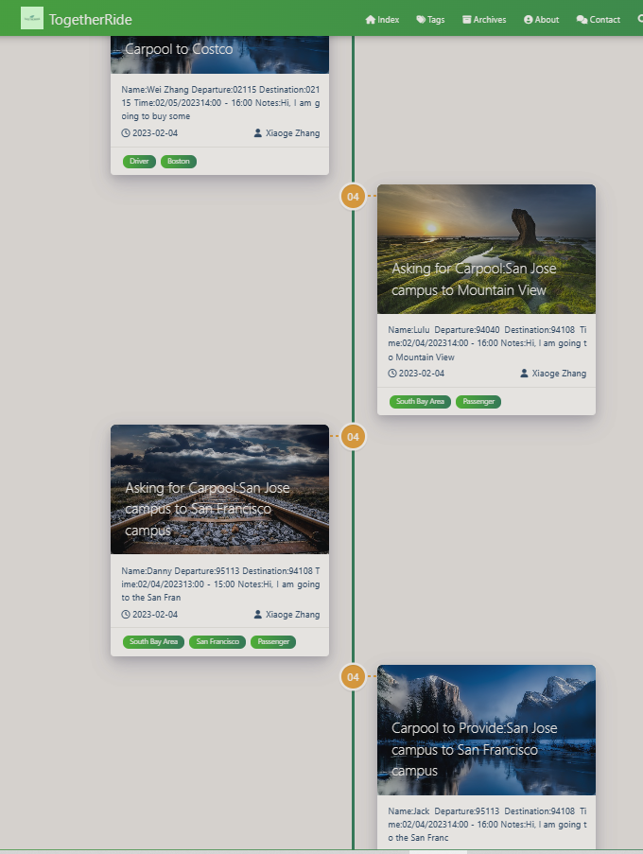
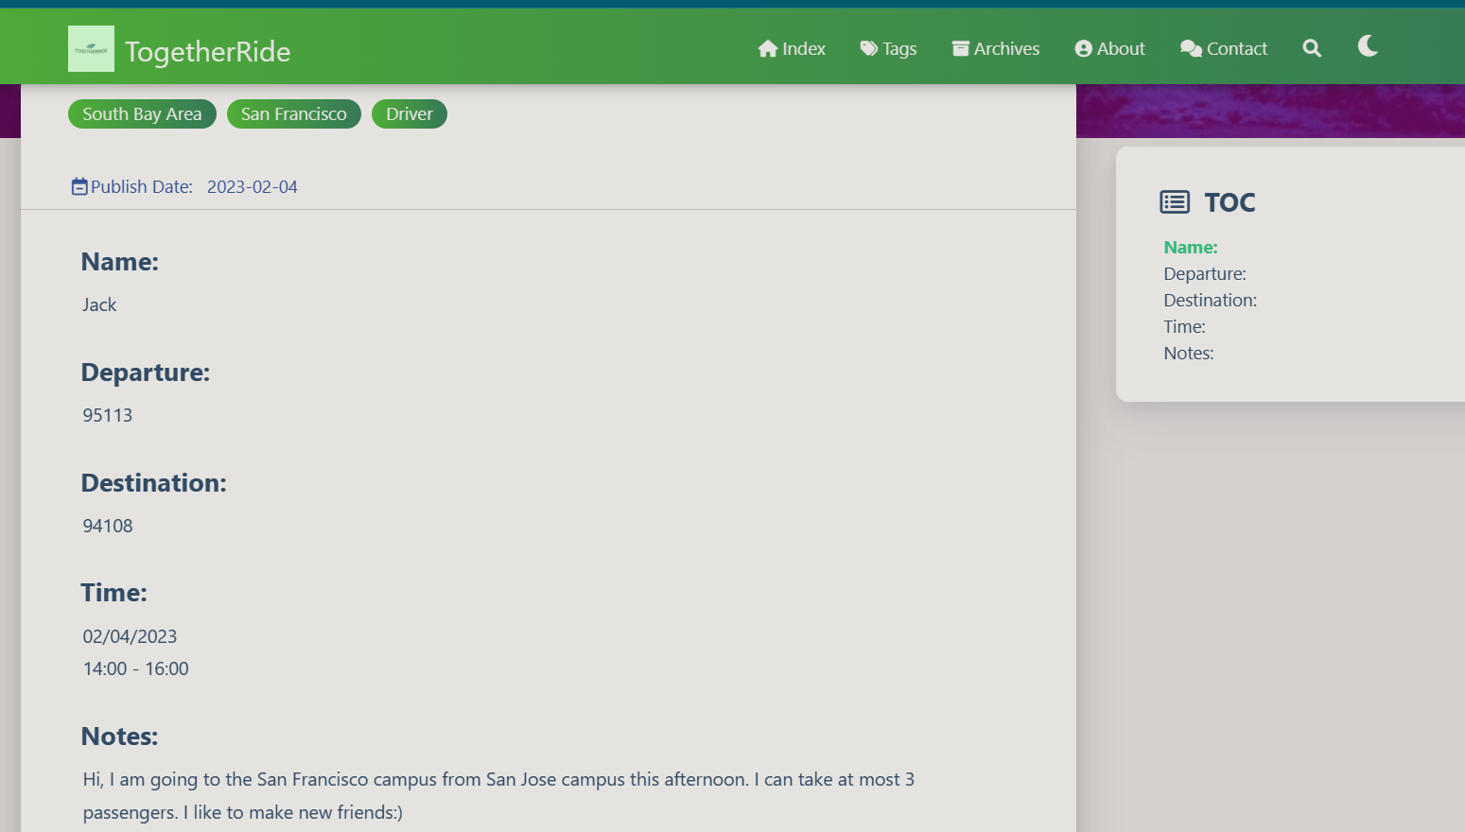

Slide 7
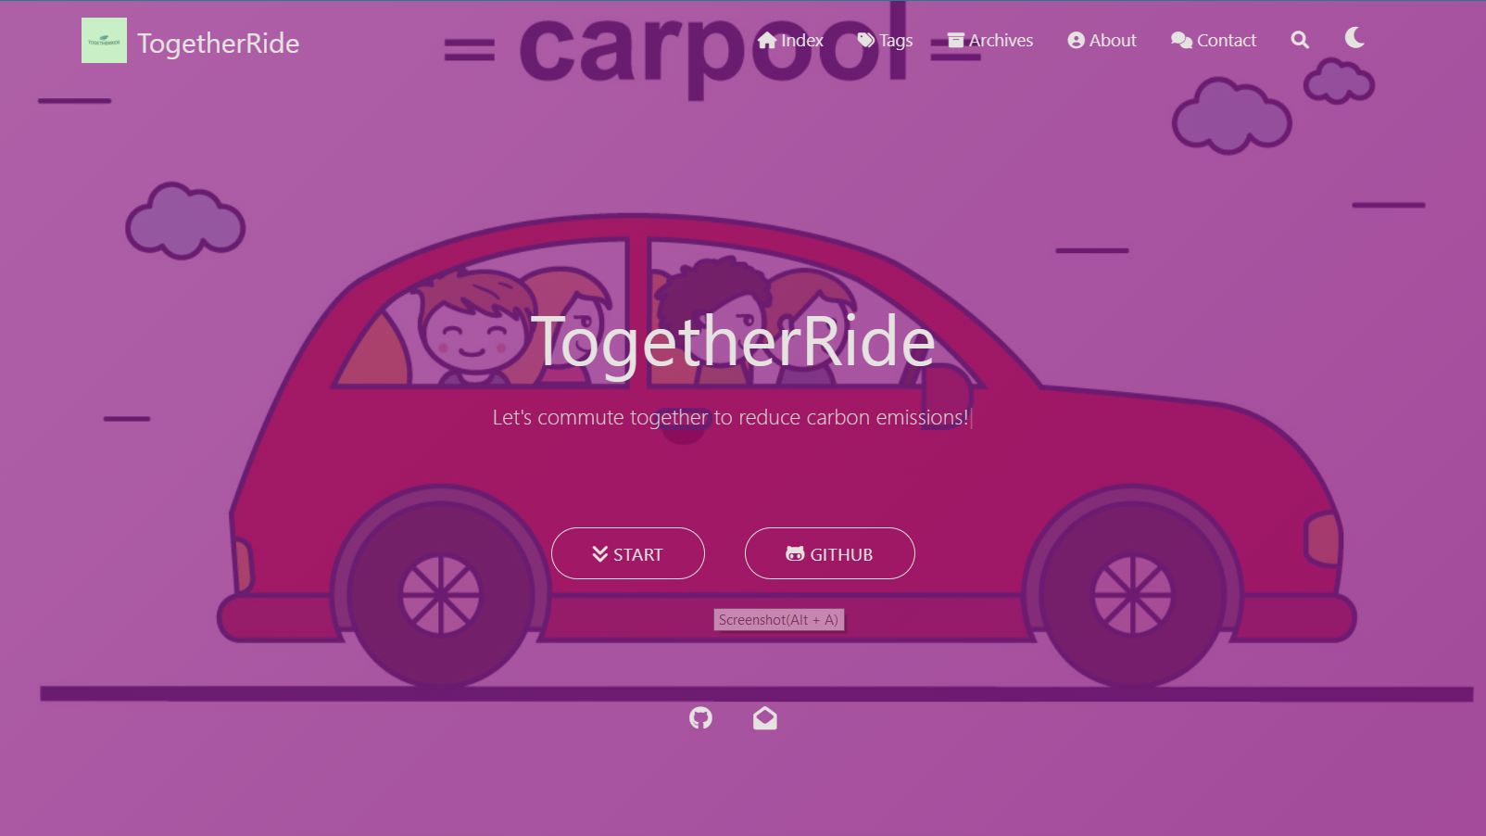
GitHub Repo
Website:
https://huskyhackathon2023.github.io/
https://github.com/HuskyHackathon2023/HuskyHackathon2023.github.io

Slide 8
Achievement I am proud of
Environmental impact
Encouraging interaction and community

Slide 9
Challenges
Technical difficulties: Building a carpool app that integrates seamlessly with a variety of devices and platforms was a complex technical challenge. We faced difficulties in ensuring that the app was intuitive and easy to use, while also being highly functional and secure.
User adoption: Getting people to adopt and use the app was a challenge. We had to work hard to educate people about the benefits of carpooling and to encourage them to try the app.
Competition: With so many transportation apps already on the market, it was challenging to stand out and differentiate our app from the competition. We had to find ways to make our app more appealing and to convince people that it was the best option for carpooling.

Slide 10
Build with
Microsoft Azure Cloud computing: We will leverag cloud computing technologies to store and process user data, and to ensure that the app was scalable and highly available. This allow us to provide a high-quality user experience, even as the number of users grew.
Database management: We will use a relational database management system to store and manage user data, and to ensure that the app was fast, reliable, and secure.
Google Maps API Geolocation technology: This will be integrated into the app to provide mapping and navigation functionality. The Google Maps API allowed us to easily display maps and routes within the app, making it easy for users to coordinate carpools and navigate to their destinations.
Twilio API: This will be integrated into the app to provide messaging functionality. The Twilio API allow us to create an in-app messaging system, making it easy for users to communicate with one another and coordinate carpools.

Slide 11
Thanks!

